Slide 1
DRUG DEVELOPMENT
AND CONTROL

Slide 2
The development of drugs is both lengthy and expensive:
* average of 7 years of testing
* usually costs millions of dollars
Many
steps
are
involved
(you’ll need time AND money)

Slide 3
Your pharmaceutical company wants to introduce a new product to the world….
Step 1) The discovery or synthesis of a new drug with the potential for therapeutic value.
PRELIMINARY STUDIES are begun which are a series of tests run on computer models, lab media, bacteria, or fungi to see if the drug produces the desired effect and if there are any observed side effects.

Slide 4
Step 2) If the results are satisfactory, PRECLINICAL STUDIES begin, which test for safety and efficacy on lab animals. Sometimes the target species is also used.

Slide 5


Slide 6
Scientists are looking for signs of :
- short-term toxicity: reactions occurring hours after dosing such as convulsions or paralysis
- long-term toxicity: 3-24 months of regular dosing to check for organ damage. Animal is euthanized to examine the effects on tissues.
- systems-oriented screening: tests the drug’s effect on the body systems – specifics on how it affects the cardiovascular, nervous systems, etc.
- reproductive effects: does it effect ovulation, conception, or pregnancy
-carcinogenicity: do large doses for a prolonged time cause tumors?
-teratogenicity: are fetal defects caused by administering the drug to pregnant animals?

Slide 7
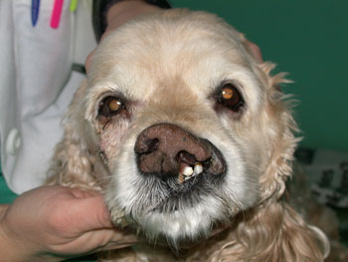
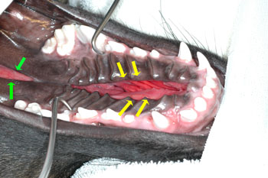
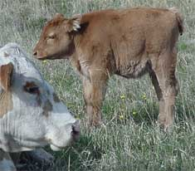
Examples of teratogenicity

Slide 8
Continued…
Step 3) If the preclinical trials are satisfactory, an application for an INAD (Investigational New Animal Drug) is filed with the FDA.
- NOTE: If the product is a pesticide, the application is filed to the EPA (Environmental Protection Agency), if it is a biologic (vaccines), it is filed with the USDA.
-The FDA responds within 30 days. Approval gives the go-ahead for clinical trials to begin

Slide 9
Cont’d….
Step 4) Clinical trials – Safety, efficacy, side effects, tissue residue, withdrawal times, and shelf life are tested in the target species.

Slide 10

ADVERSE REACTIONS
Pre-approval clinical trials
Following treatment with REVOLUTION, transient localized alopecia with or without inflammation at or near the site of application was observed in approximately 1% of 691 treated cats. Other signs observed rarely (≤0.5% of 1743 treated cats and dogs) included vomiting, loose stool or diarrhea with or without blood, anorexia, lethargy, salivation, tachypnea, and muscle tremors.
Post-approval experience
In addition to the aforementioned clinical signs that were reported in pre-approval clinical trials, there have been reports of pruritis, urticaria, erythema, ataxia, fever, and rare reports of death. There have also been rare reports of seizures in dogs (see WARNINGS)

Slide 11
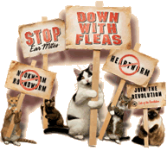
http://www.revolution4cats.com/display.asp?country=US&lang=EN&drug=RV&species=FL&sec=010
SAFETY
REVOLUTION has been tested safe in over 100 different pure and mixed breeds of healthy dogs and over 15 different pure and mixed breeds of healthy cats, including pregnant and lactating females, breeding males and females, puppies six weeks of age and older, kittens eight weeks of age and older, and avermectin-sensitive collies. A kitten, estimated to be 5–6 weeks old (0.3 kg), died 8 1⁄2 hours after receiving a single treatment of REVOLUTION at the recommended dosage. The kitten displayed clinical signs which included muscle spasms, salivation and neurological signs. The kitten was a stray with an unknown history and was malnourished and underweight (see PRECAUTIONS).

Slide 12
Dogs
In safety studies, REVOLUTION was administered at 1, 3, 5, and 10 times the recommended dose to six-week-old puppies, and no adverse reactions were observed. The safety of REVOLUTION administered orally also was tested in case of accidental oral ingestion. Oral administration of REVOLUTION at the recommended topical dose in 5- to 8-month-old beagles did not cause any adverse reactions. In a pre-clinical study selamectin was dosed orally to ivermectin-sensitive collies. Oral administration of 2.5, 10, and 15 mg/kg in this dose escalating study did not cause any adverse reactions; however, eight hours after receiving 5 mg/kg orally, one avermectin-sensitive collie became ataxic for several hours, but did not show any other adverse reactions after receiving subsequent doses of 10 and 15 mg/kg orally. In a topical safety study conducted with avermectin-sensitive collies at 1, 3 and 5 times the recommended dose of REVOLUTION, salivation was observed in all treatment groups, including the vehicle control. REVOLUTION also was administered at 3 times the recommended dose to heartworm infected dogs, and no adverse effects were observed.
Cats
In safety studies, REVOLUTION was applied at 1, 3, 5, and 10 times the recommended dose to six-week-old kittens. No adverse reactions were observed. The safety of REVOLUTION administered orally also was tested in case of accidental oral ingestion. Oral administration of the recommended topical dose of REVOLUTION to cats caused salivation and intermittent vomiting. REVOLUTION also was applied at 4 times the recommended dose to patent heartworm infected cats, and no adverse reactions were observed.
In well-controlled clinical studies, REVOLUTION was used safely in animals receiving other frequently used veterinary products such as vaccines, anthelmintics, antiparasitics, antibiotics, steroids, collars, shampoos and dips.

Slide 13
Continued…..
Step 5) If the clinical trial results are satisfactory, a NADA (New Animal Drug Application) is filed with the FDA.
-If approved, the product is licensed and manufactured and continues to be monitored as long as it is produced.

Slide 14
TOXICITY
Toxicity evaluations also determine the dose that causes organ or tissue damage, permanent injury, or death.
The EFFECTIVE DOSE is the dose that causes the desired effect in 50% of the animals receiving the drug. (ED₅₀)
The LETHAL DOSE is the dose that causes death in 50% of the animals that receiving the drug. (LD₅₀)
The effective dose and lethal dose help to determine the MARGIN OF SAFETY or THERAPEUTIC INDEX which is the ratio or difference in magnitude between the effective dose and lethal dose of a drug. (LD₅₀/ED₅₀)

Slide 15
The THERAPEUTIC INDEX is used to measure the safety of a drug. The larger the TI, the safer the drug.
EXAMPLE:
Drug A is designed to lower heart rate. The
drug is given to 100 mice.
The drug causes 50% of the mice to have a lower heart rate a dose of 2 mg per pound. This is the effective dose.
The drug is then given at 100 mg per pound and 50% of the mice die. This is the lethal dose.
.

Slide 16
DRUG A continued..
The Therapeutic Index is then calculated for Drug A:
TI = LD₅₀/ED₅₀
TI = 100 mg per pound/2 mg per pound
TI = 50
Since the Therapeutic Index is 50, one would have to ingest 50 times the effective dose to ingest the lethal dose.

Slide 17
DRUG B
Drug B is also used to lower heart rate. It is given to 100 mice and produces a lower heart rate in 50 mice at 10 mg per pound (effective dose).
When Drug B is given at a dose of 20 mg per pound, 50 mice die (lethal dose).
TI = LD₅₀/ED₅₀ = 20 mg per lb/10 mg per lb = 2
For Drug B, the TI is 2, which means that one would have to ingest twice the effective dose to ingest the lethal dose.

Slide 18
Which drug is safer?
DRUG A ) TI = 50
DRUG B) TI = 2
DRUG A has the higher THERAPEUTIC INDEX or MARGIN OF SAFETY.

Slide 19


Veterinarians can purchase drugs in a variety
Of ways:
DIRECT MARKETING- The company that manufactures
the drug sells it directly to the veterinarian (ex: Pfizer,
Merial)
DISTRIBUTOR/WHOLESALER- A company that purchases
drugs from manufacturers and then resells them to
veterinarians (MWI, Webster)

Slide 20
GENERICS
GENERIC COMPANIES- Companies that sell drugs that are no longer under patent protection
Patent expires → company applies to FDA to sell generic equivalent (ANAD – abbreviated new drug application) → no clinical data is required if the product has the same active ingredients, potency, dosage, and label → applicant proves that the new product’s bioequivalency (similar absorption providing similar blood levels as original product).

Slide 21
CHARLEY
http://www.youtube.com/watch?v=dJQG6V1MOVY
an example of teratogenicity- cerebellar hypoplasia (most likely due to vaccination of the queen during gestation)

